Slide 1
How can you predict a book's popularity based on its characteristics?
Litan Idesis
DATA SCIENCE PROJECT

Slide 2
Stages of the research:
Acquisition - Data Acquisition refers to the process of collecting and gathering data from various sources.
Eda - Exploratory Data Analysis is an approach to analyze and summarize the main characteristics, patterns, and insights of a dataset, often using visual and statistical methods. This stage includes cleaning the data from outliers and data that might mislead our analysis.
ML - Using Machine Learning Algorithms to predict the success of a book based on various characteristics.

Slide 3
Data acquisition – Crawling:
Access the website and obtain data using Crawling.
The URL of our the site is: https://www.goodreads.com.
The goal is to create a model that gets a book name and is able to predict its rating based on other characteristics.
Packages used during the Acquisition stage:
import requests
import html
import time
import pandas as pd
from bs4 import BeautifulSoup
import random
from selenium import web driver
from selenium.webdriver.chrome.service import Service

Slide 4


Slide 5
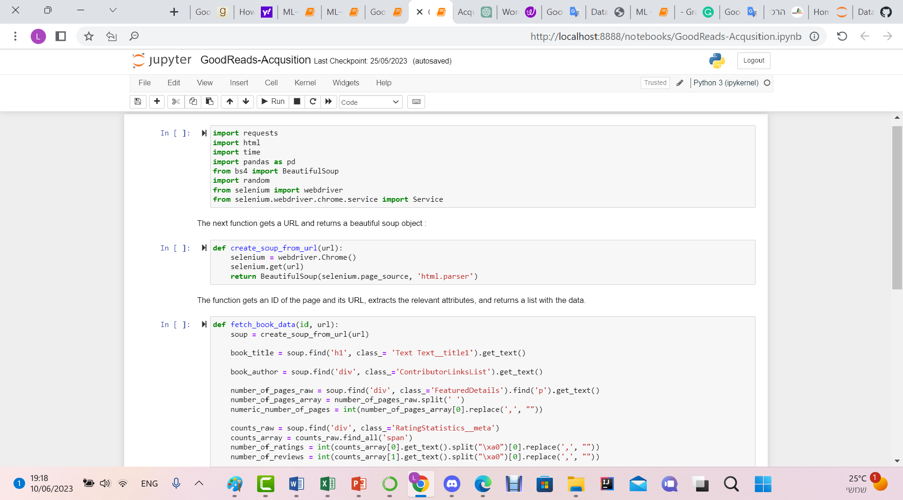
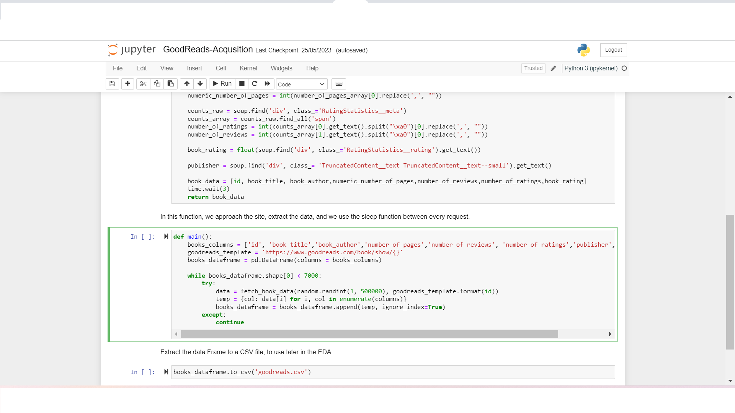
DATA Acquisition state -

Slide 6
EDA - Exploratory Data Analysis :
Filtering and Clearing the Data – To enhance the data quality, it is essential to filter out undesirable values such as nulls, explore correlations within the data, examine the number of rows and columns, and Identify and resolve data imbalances.
Visualization - In order to analyze the distribution, relationships, and patterns in the data, EDA uses a variety of data visualization tools. Visualizations such as histograms, scatter plots, and box plots can provide insights into the data's central tendencies, variations, outliers, and potential trends.
Summary Statistics - To gain a numerical understanding of the dataset, EDA computes summary statistics such as mean, median, standard deviation, and quartiles. As a result, these statistics can provide insights into the distribution and outliers of the variables, as well as the central tendencies, spread, and variability of the variables.
Overall, EDA plays a crucial role in understanding the data's characteristics, identifying potential issues or patterns, and guiding subsequent steps in the data analysis and modeling process.

Slide 7
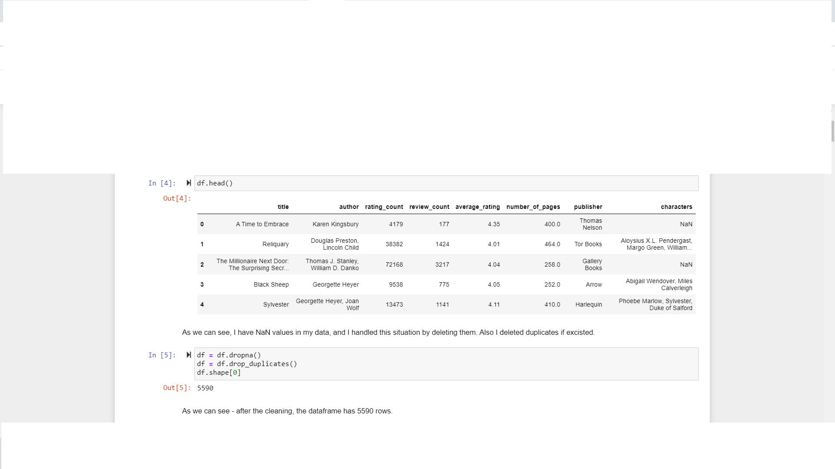
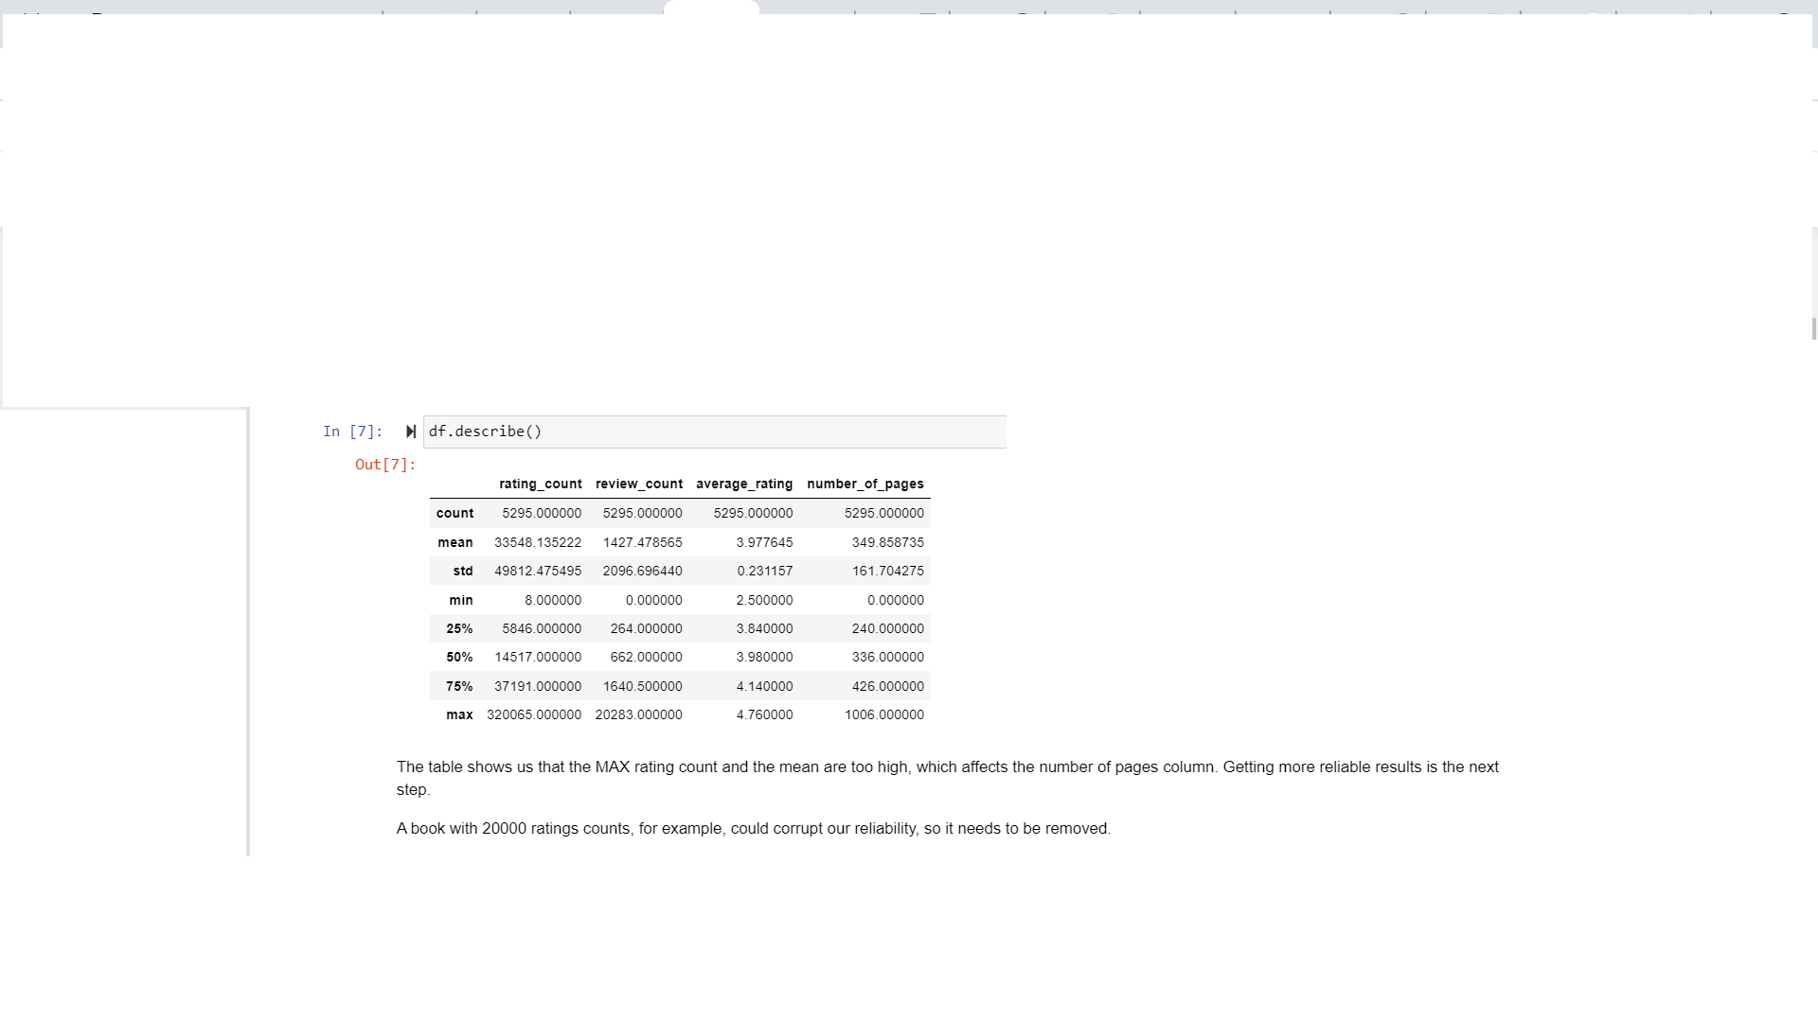
DATA Acquisition state -

Slide 8
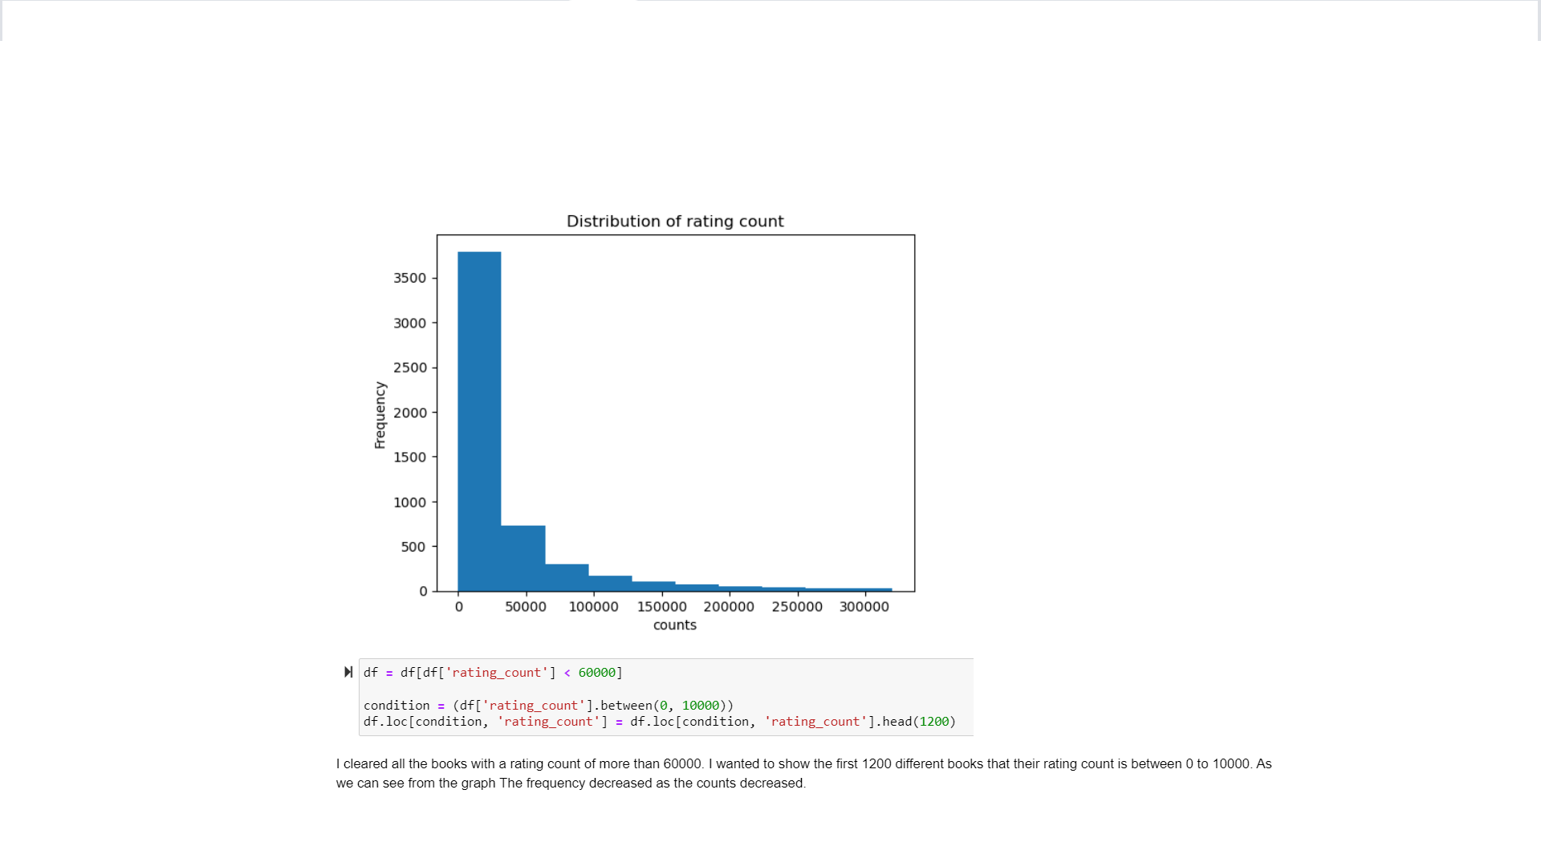
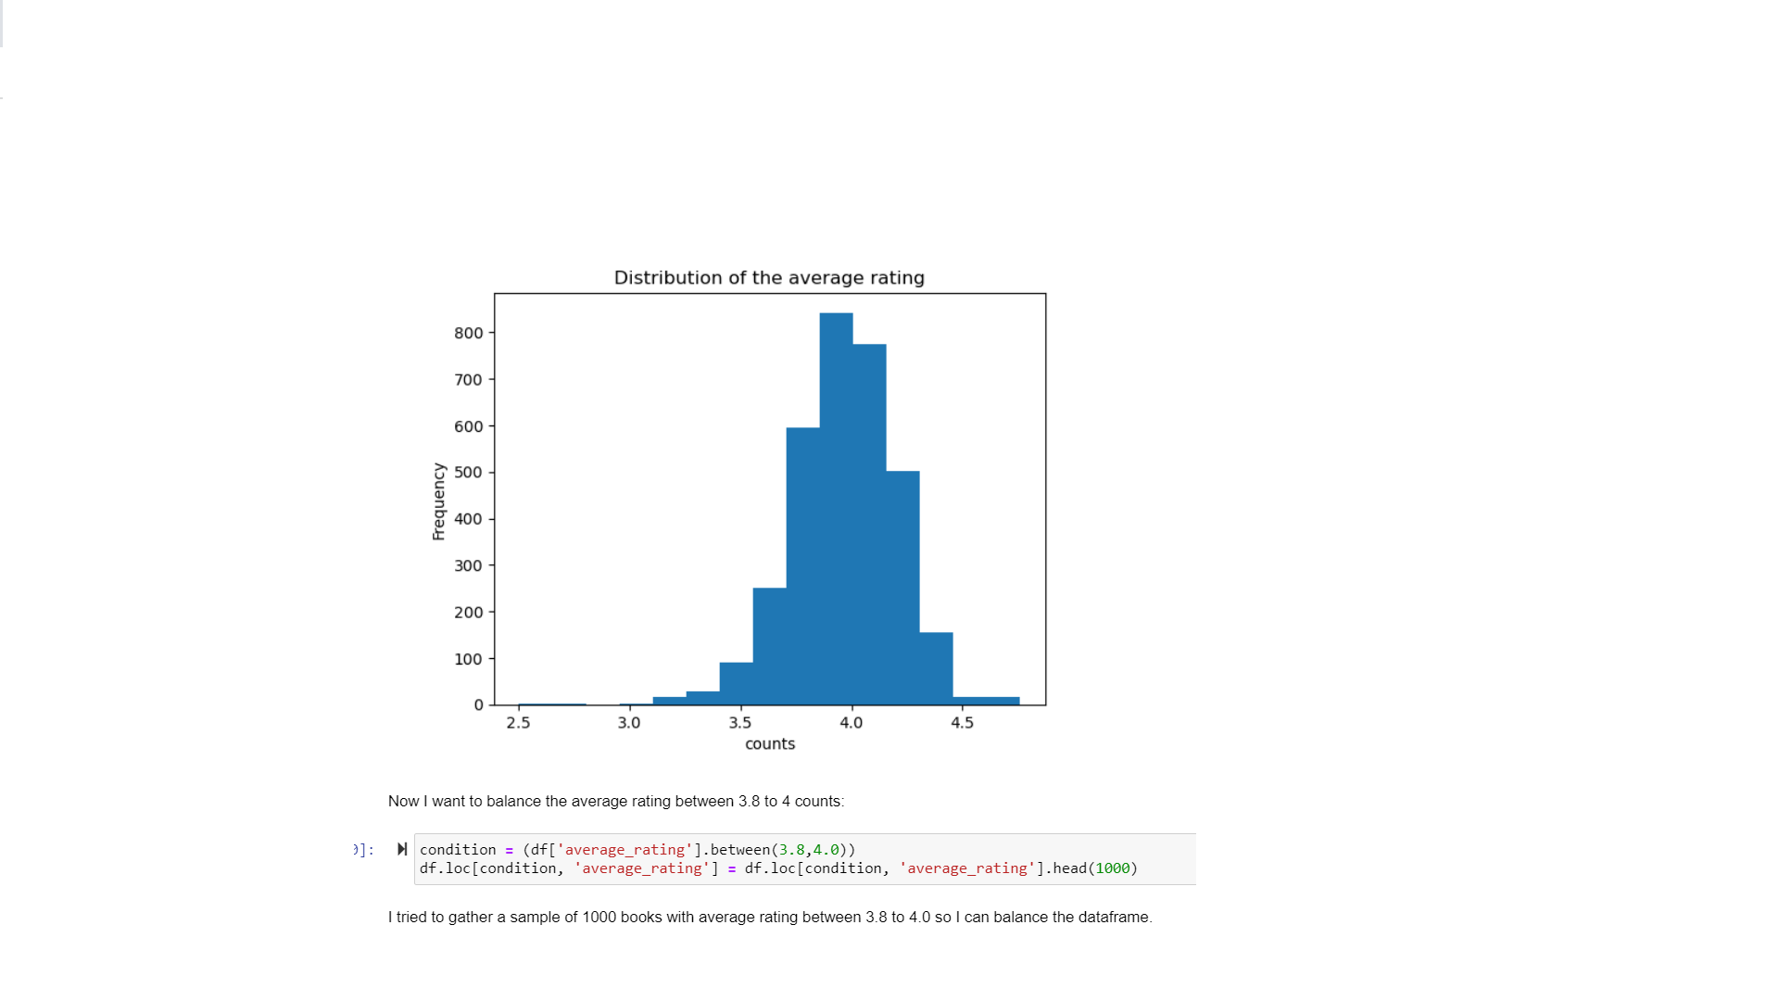
DATA Acquisition state -

Slide 9
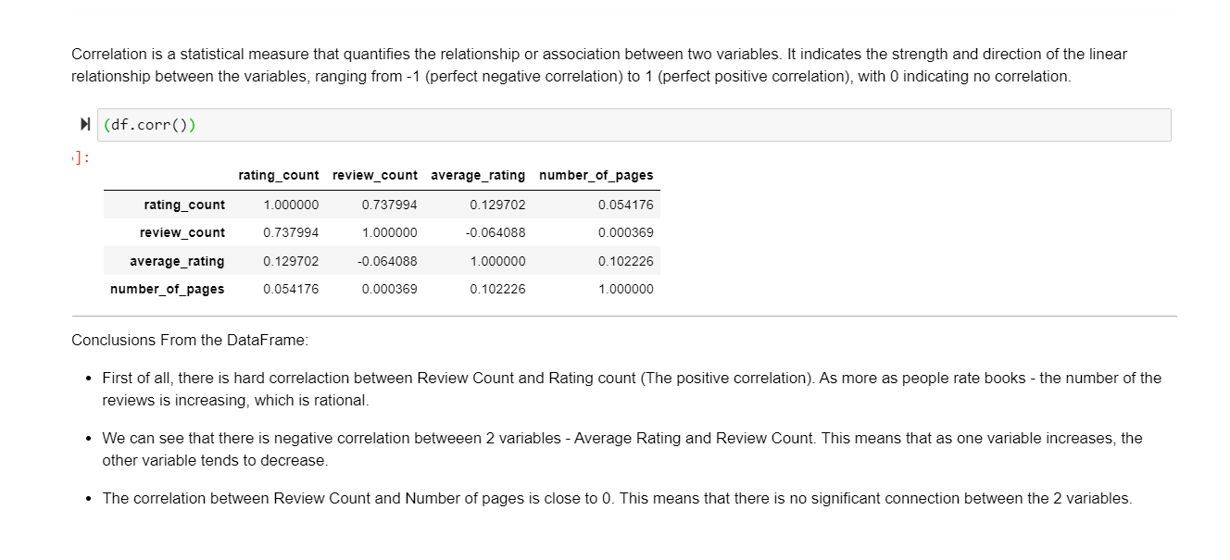
Correlation & CONCLUSIONS -

Slide 10
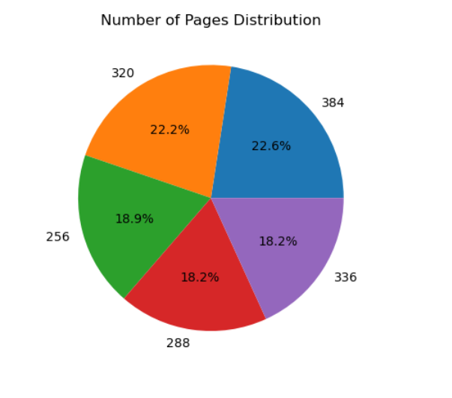
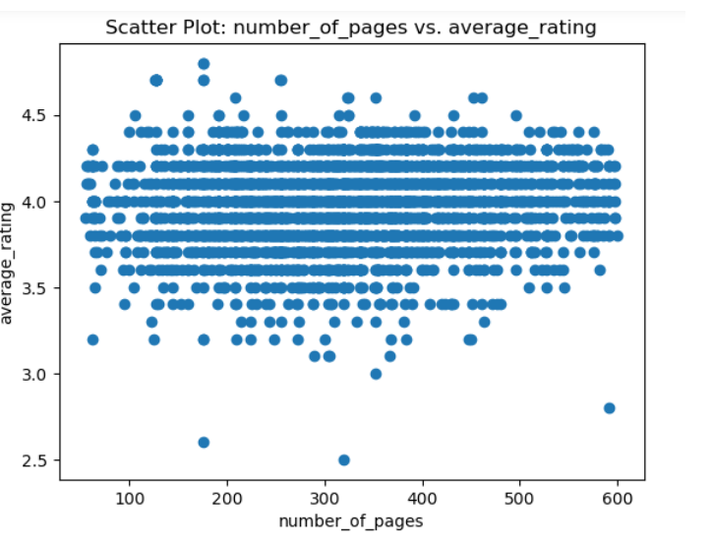
Graphs -
The pie chart above describes the top 5 distribution of the data, regarding number of pages in the data set.
The Scatter Plot describes the connection between Average Rating and Number Of Pages.

Slide 11
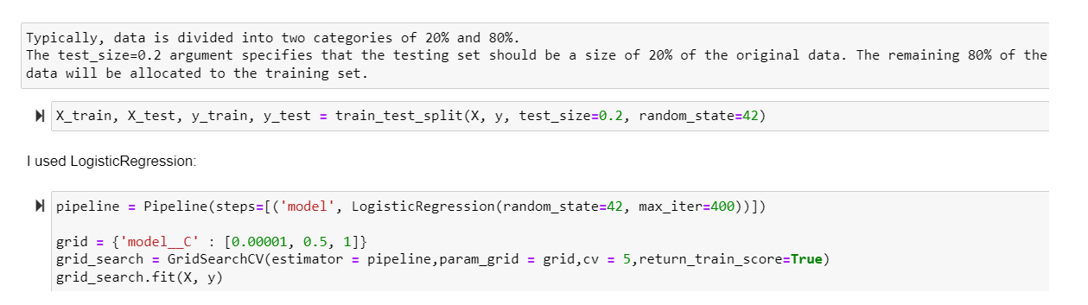
Machine learning
First I imported the learning packages (Import sklearn).
I used the OneHotEncoder library which converts categorical values into binary values.
My algorithm is a logistic regression because I am describing exactly what the model is required to predict - the rating of the book based on other characteristics that I have. I have the property values of all instances that with them I will build a model. These data are marked with a large X and the value we wish to predict will be marked with a small y value. Another example of use in machine learning is training test split which divides the data into 2 groups of 20% and 80%.
Because my model's results weren't good, I searched the Internet for ways to improve it. I found an option called Grid Search. How does a grid search work? It basically runs my model many, many times, each time with different parameters. The best results will be saved, allowing me to get the best results possible.

Slide 12
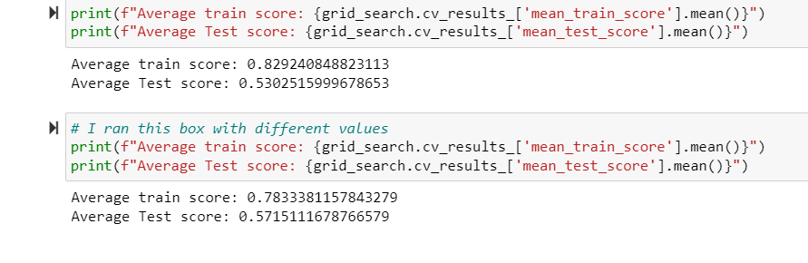
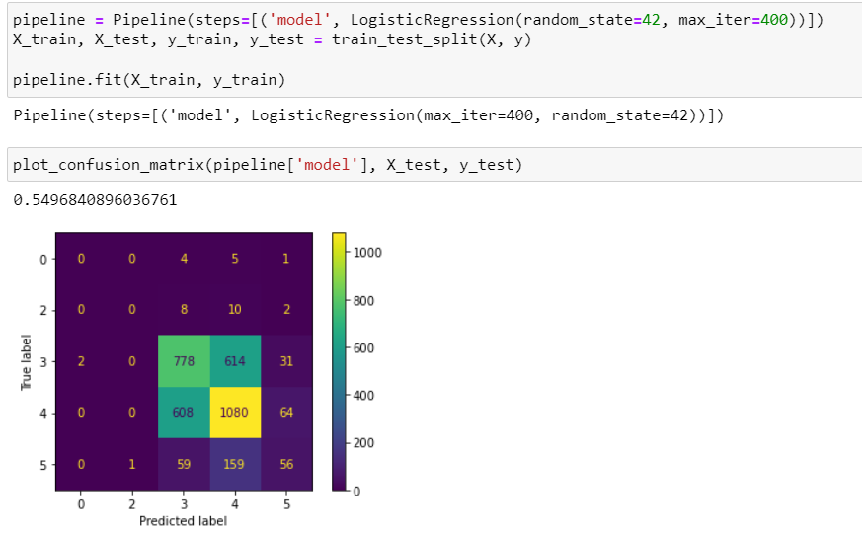
Machine learning – grid search:
Trying Logistic Regression with another parameters :

Slide 13
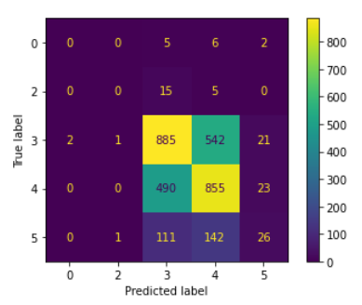
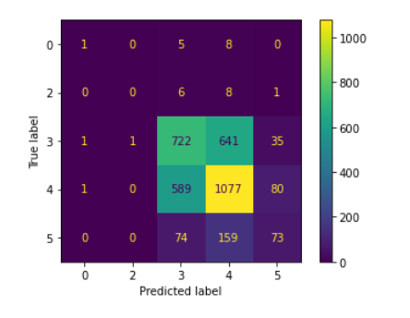
LETS TEST Random Forest:
Random Forest is a machine learning algorithm used for both classification and regression tasks in data science. It is an ensemble learning method that combines multiple decision trees to make predictions.

Slide 14
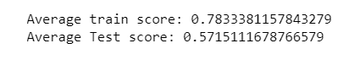
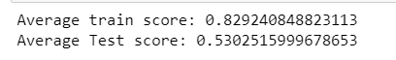

Conclusions:
My attempt to improve performance was based on various methods, and the root problem is the data - many Goodreads users rate books with three to five stars, creating instability in the data.
Based on the results above, the algorithm converges to about 0.53 to 0.58 percent precision.

Slide 15

Thank you!
THANK YOU!

